Slide 1

Scrum Master Certification
Image Placeholder

Slide 2
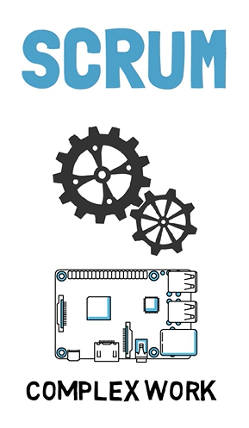
What is Scrum?
Scrum is a lightweight framework that helps people, teams, and organizations generate value through adaptive solutions for complex problems.

Slide 3
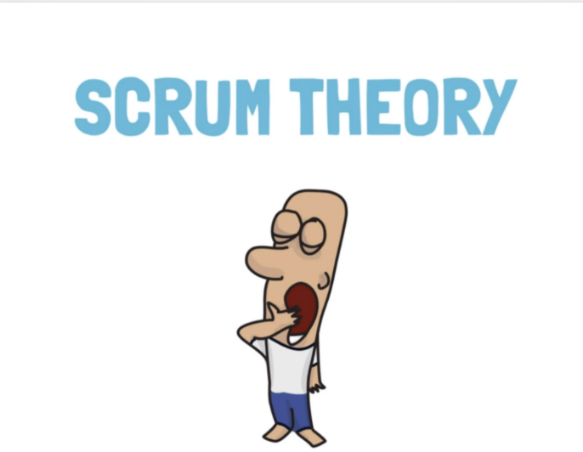

Slide 4

SCRUM
Empirical process of control theory
=
Empiricism
& Lean Thinking

Slide 5
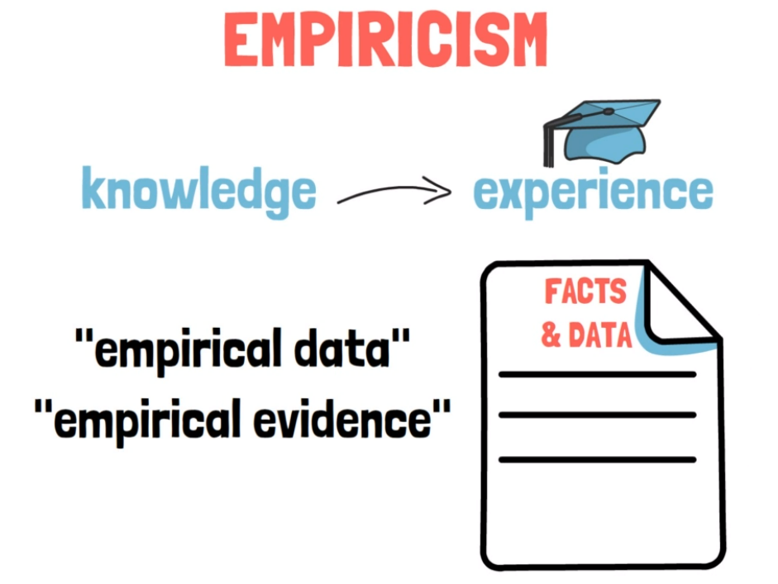

Slide 6
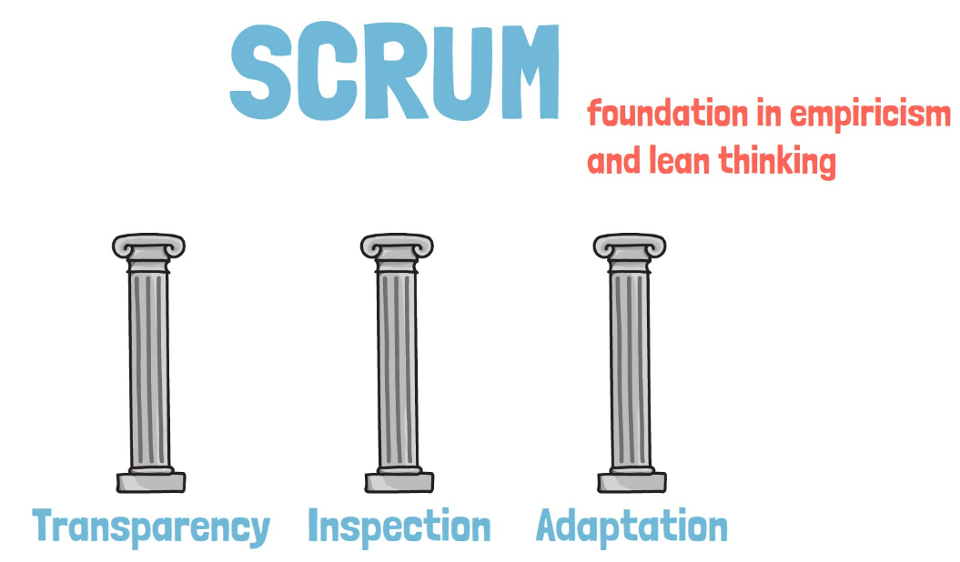

Slide 7
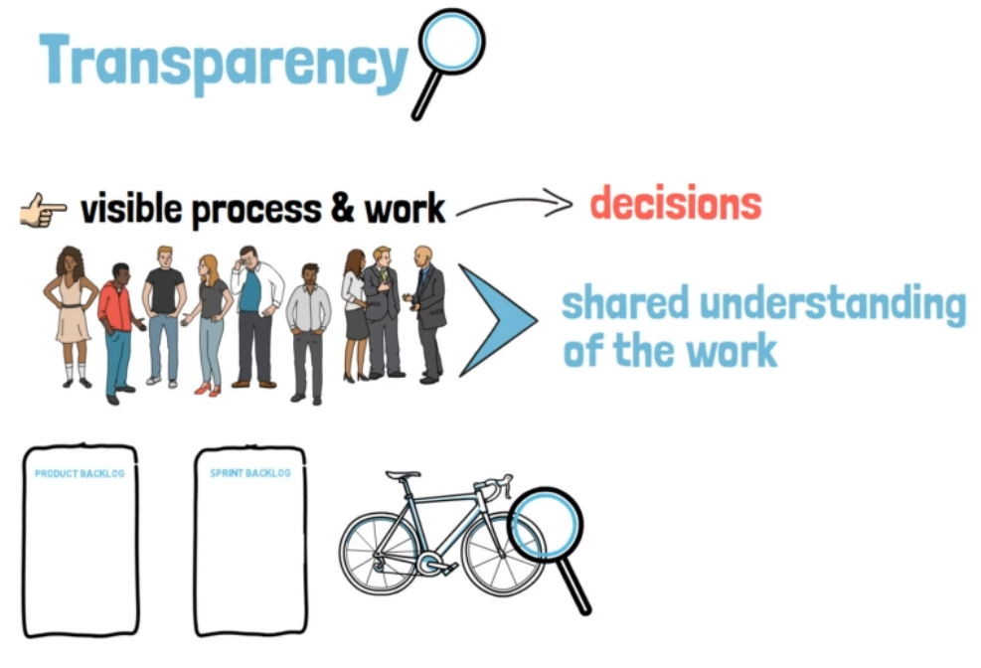
Transparent does not only mean that you need to be visible or accessible to everyone involved.
It is actually more than that.
Everyone involved in the process needs to have a shared understanding of the work.

Slide 8
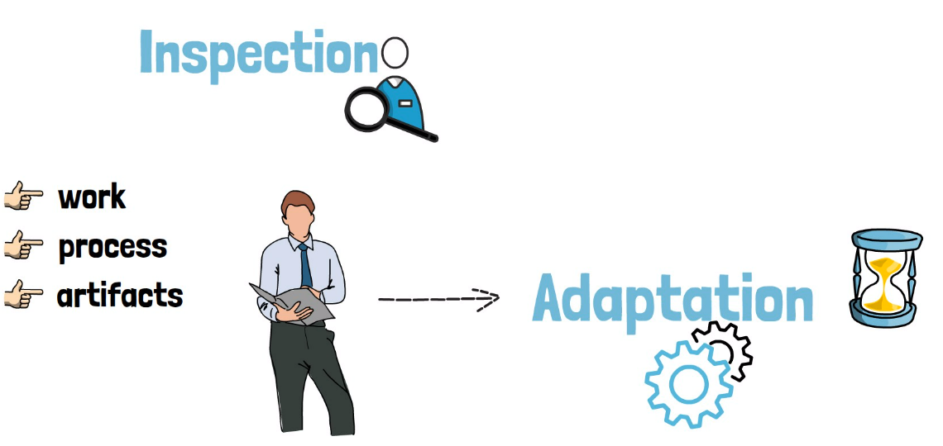
In Scrum, constant inspection of work, the process and the artifacts is done.
As soon as the inspection is over adaptation needs to be made as soon as possible.

Slide 9
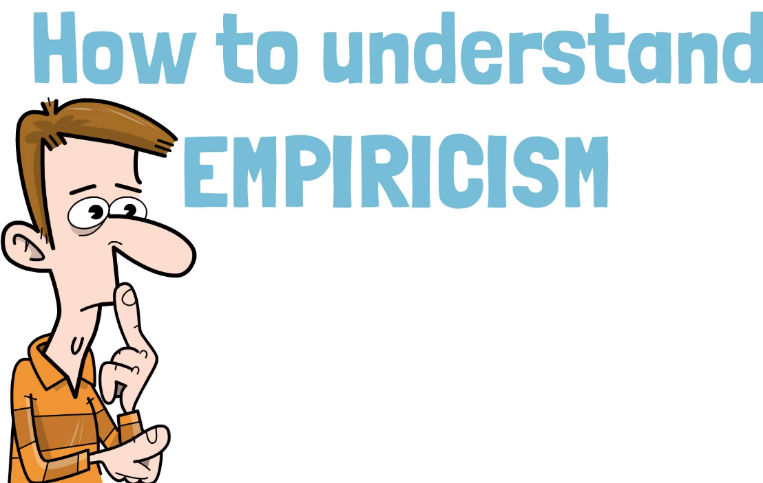

Slide 10
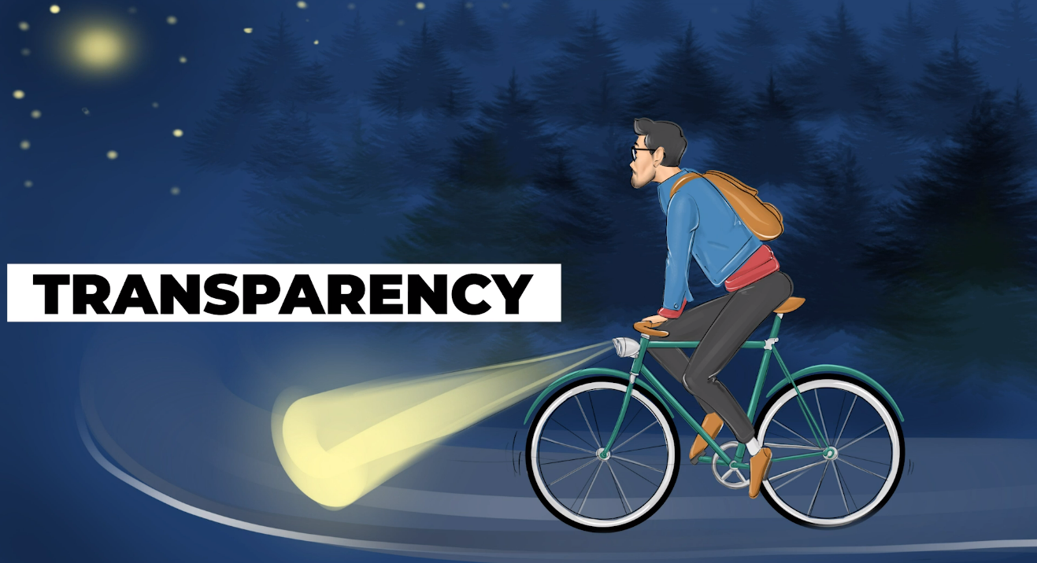
Analogy to understand empiricism better.
Say you are riding your bike and it is getting dark outside. You can hardly see anything. You turn on your headlight. Now you can better see the road ahead and where you are going.

Slide 11
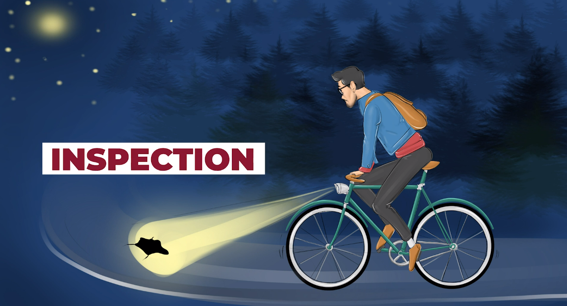
All of a sudden you notice a large pothole right on your path.
This is

Slide 12
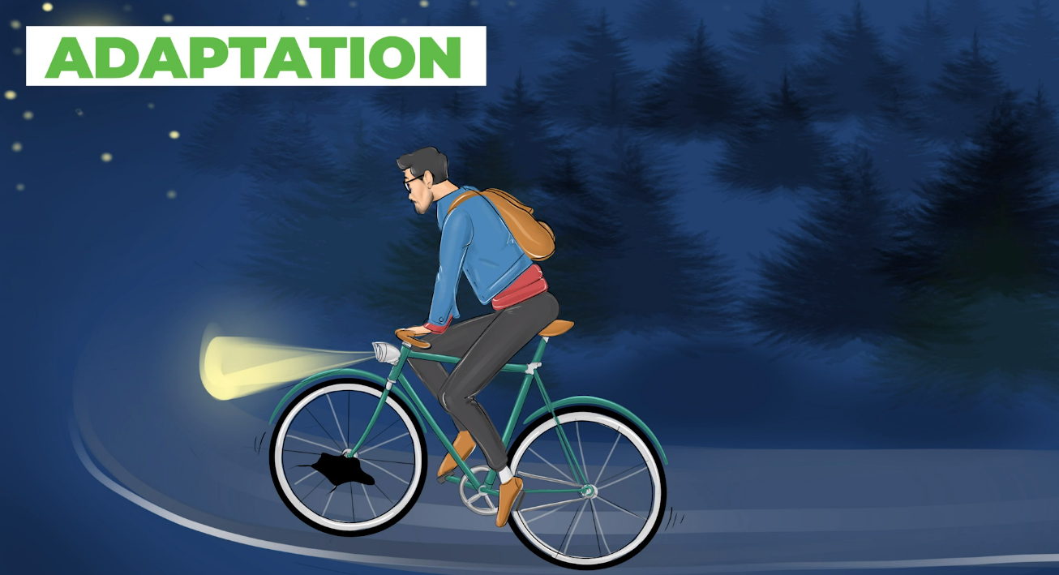
You quickly react and steer to the left, avoiding the pothole.

Slide 13

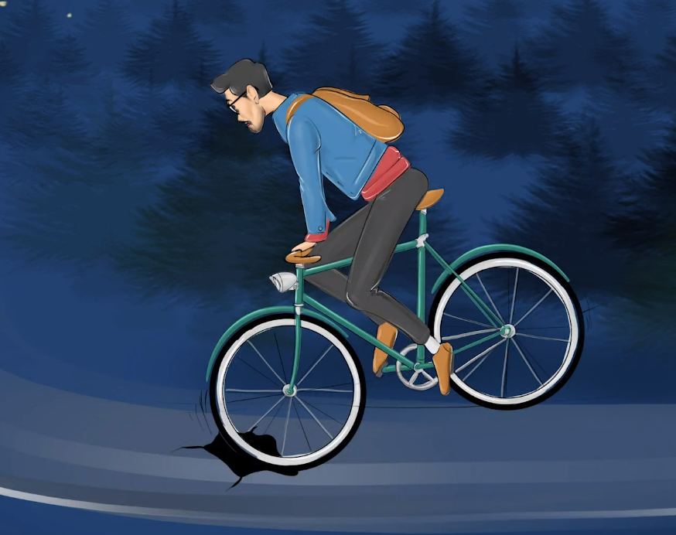
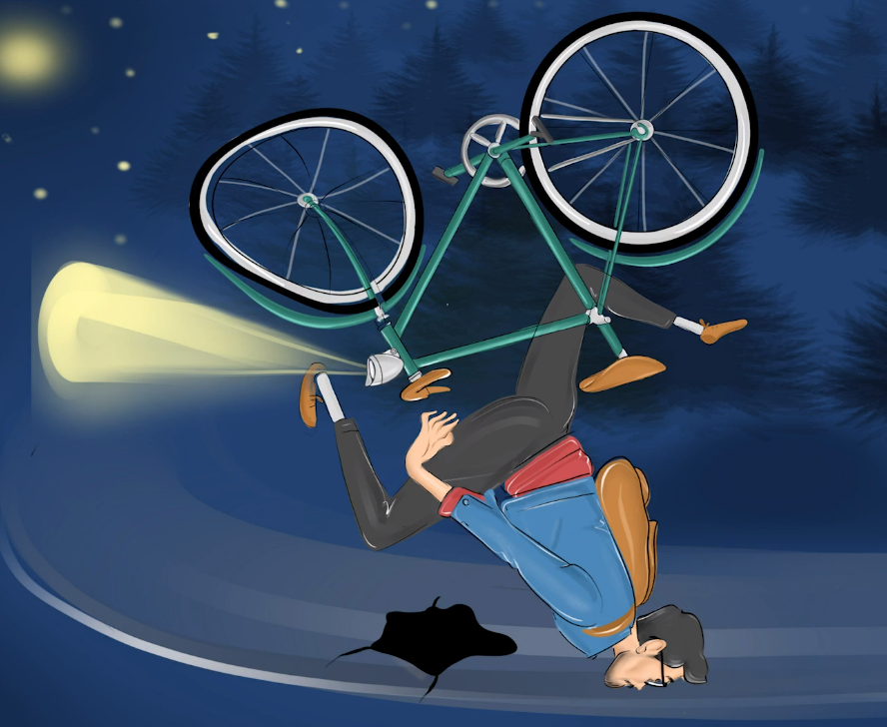
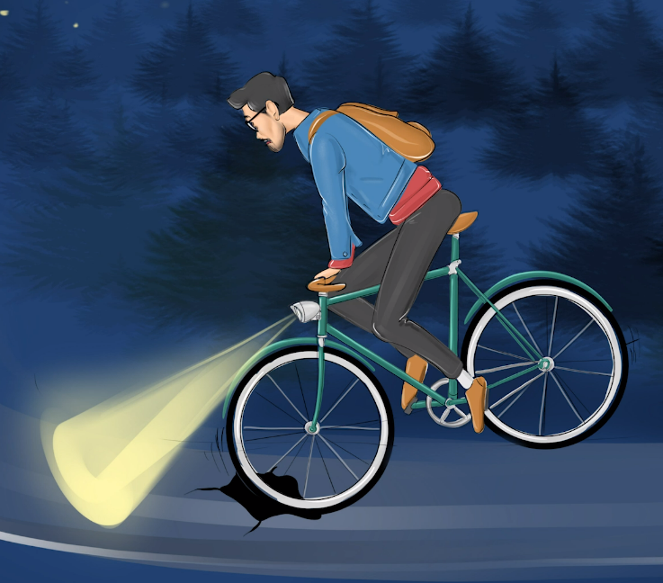
You have avoided a serious accident only because your headlight was working, you were paying attention to the road and spotted a pothole, and you had good reflexes and changed your direction in time.
If you did not have your headlights on, you would not have spotted a pothole and caused an accident.
If you had your headlights on, but you were distracted and not looking at the road, again, you would have caused an accident.
If you had your headlights on and were not distracted but still failed to take any avoiding action, you would still have caused an accident.

Slide 14
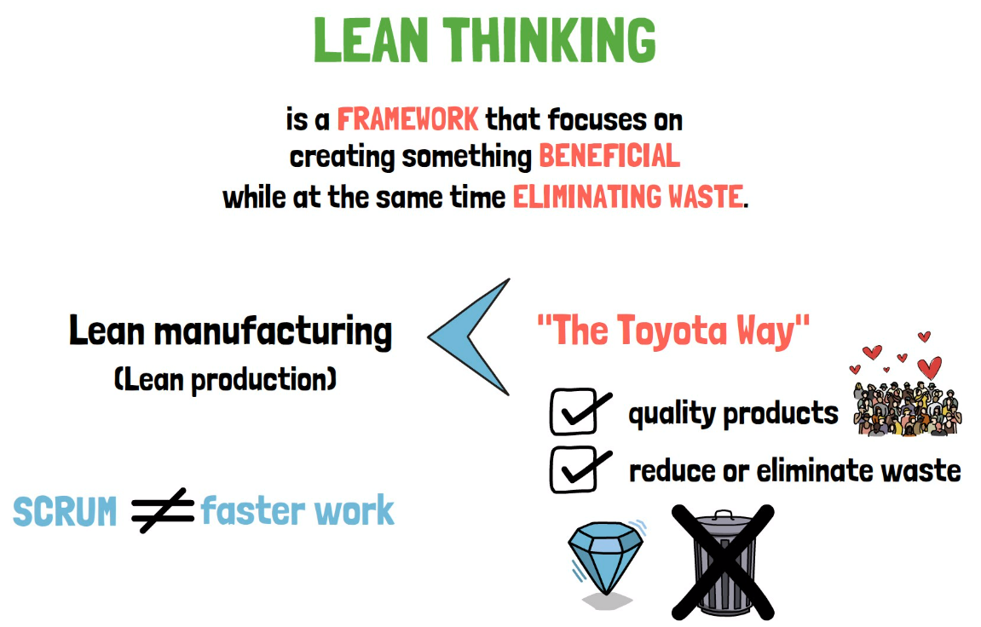

Slide 15
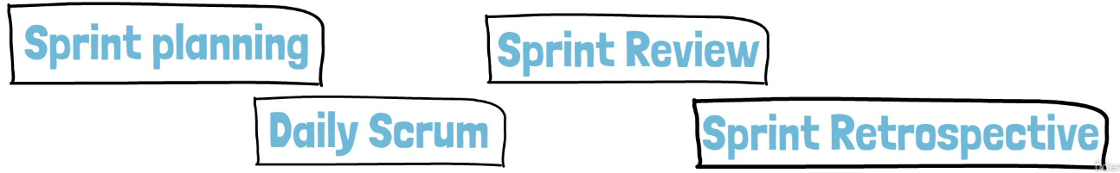
Scrum has four dedicated events:

Slide 16
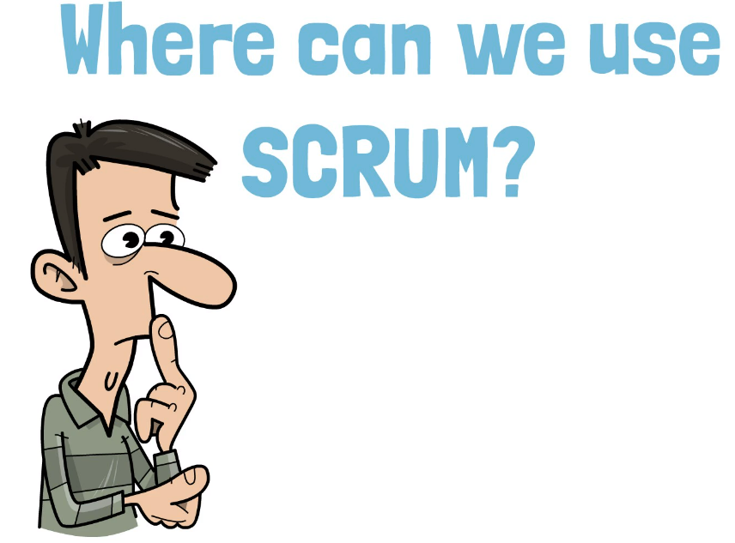

Slide 17
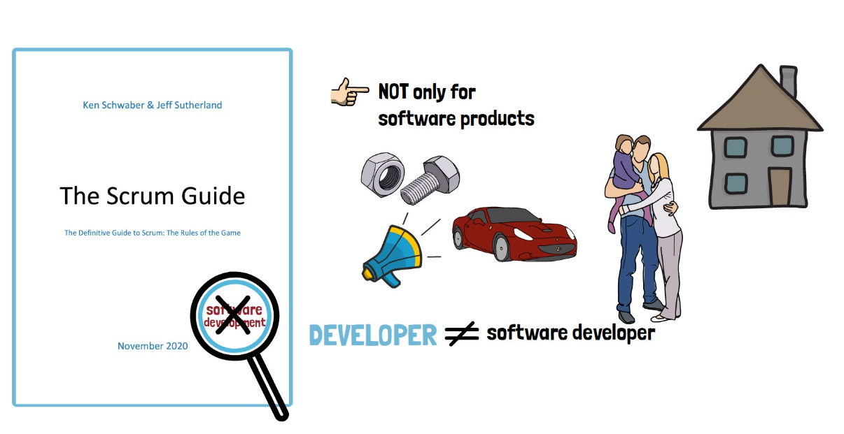
Scrum has been successfully used in developing hardware products while researching self-driving cars, in marketing, and in the personal lives of the people familiar with Scrum.

Slide 18
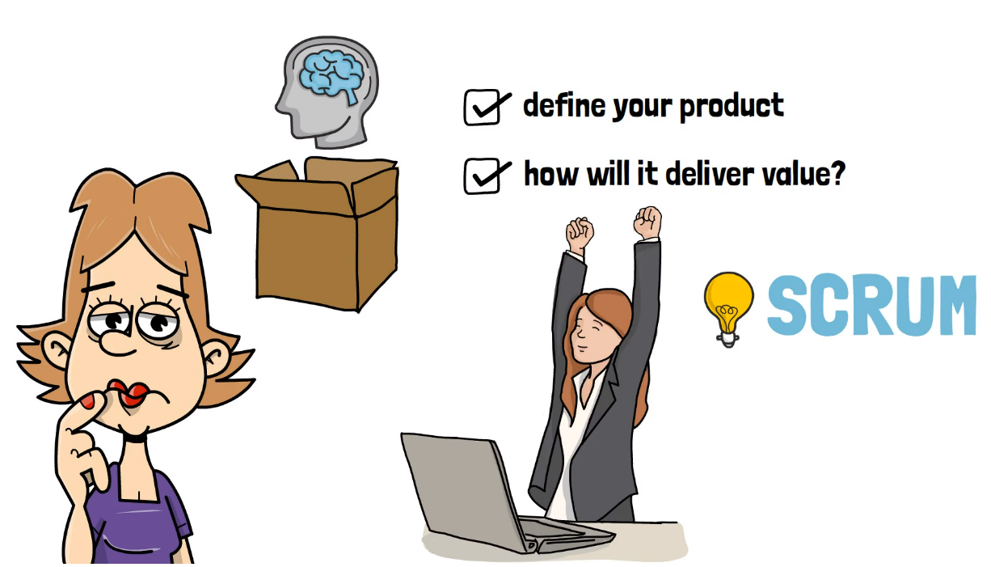
Think outside of the box and apply Scrum to areas outside of software development.

Slide 19
Scrum Values
Courage
5
1
Openness
Focus
4
2
Respect
Commitment
3

Slide 20
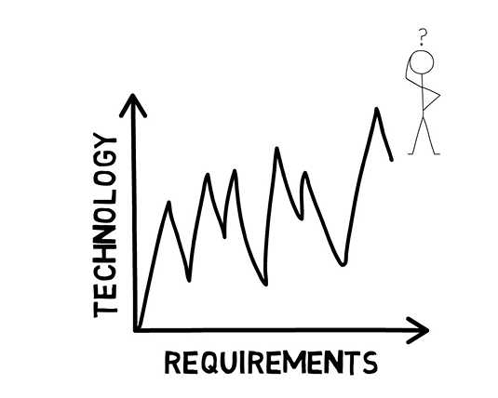
Overview of the SCRUM framework
Nowadays, with constantly changing market condition, and technology improvements, giving a high level of uncertainty.
It is impossible to predict from the beginning, how a product should be developed.

Slide 21
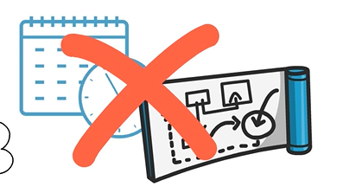
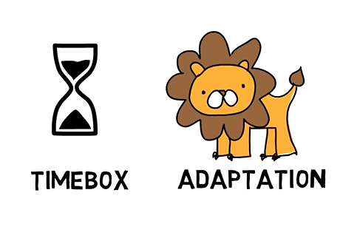
Overview of the SCRUM framework
So, in these conditions, working with time boxes and quick adaptation is mandatory to ensure that a product does not fail.
Spending six months to create a detailed plan with requirements and following that plan for another one or two years until the full product is ready to be released does not work anymore.

Slide 22
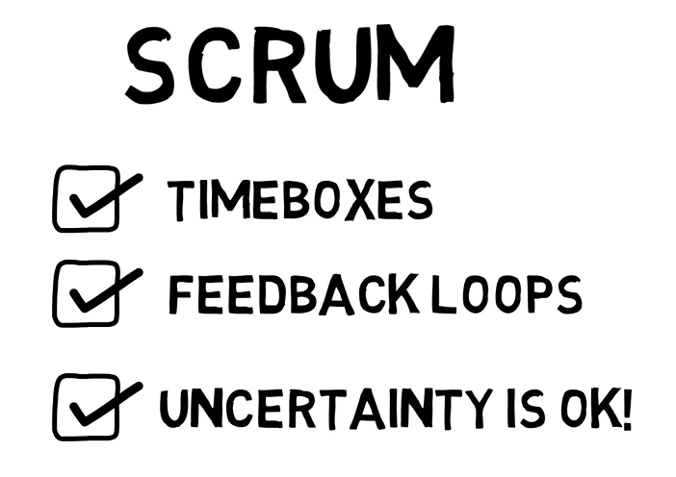
Overview of the SCRUM framework
Scrum is a framework that imposes time boxes feedback loops and encourages small increments while overall trying to deal with uncertainty.

Slide 23
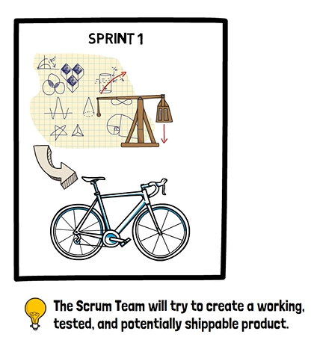
Overview of the SCRUM framework
What Scrum does is a bit of all the steps required to develop a product. This may include gathering requirements and understanding what customers want, planning, design and architecture work, development, testing, documentation and to put them in a fixed-length iteration called a sprint.
So, a sprint combines all aspects of the work required to build a product. Sprints are the heartbeat of Scrum, where ideas are turned into value.

Slide 24
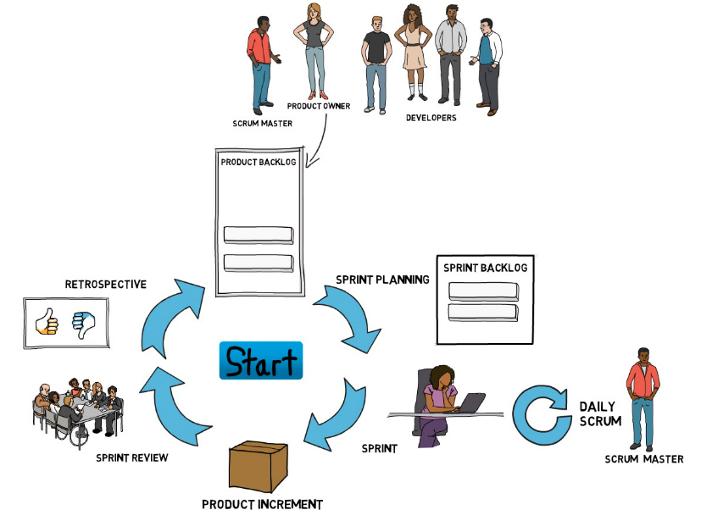
Overview of the SCRUM framework

Slide 25
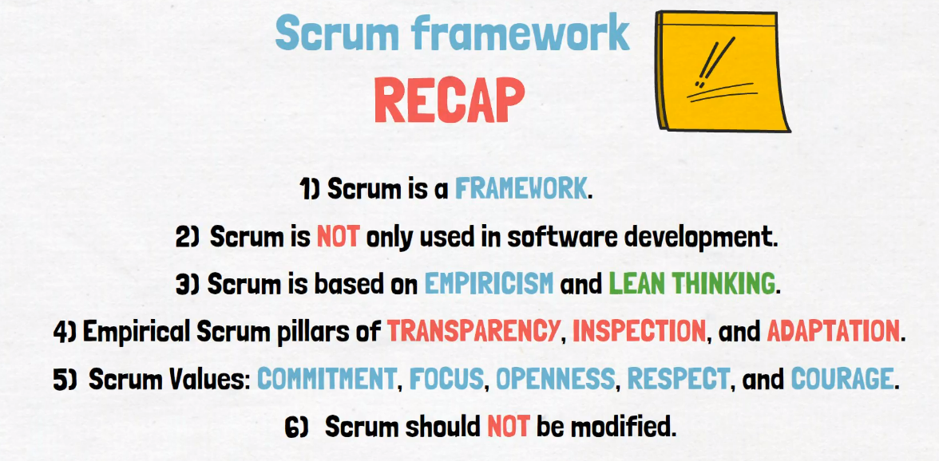

Slide 26
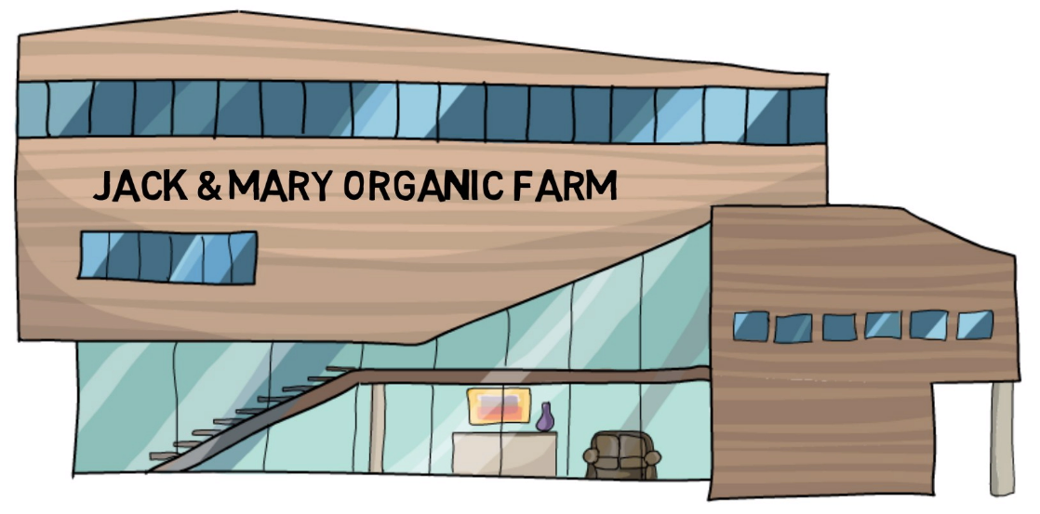
Case Study
Jack & Mary Organic Farm has a tradition of over 50 years in the market.
It specializes in the production of jams and jellies, and, as it often happens with traditional companies.
They have not really managed to keep up with the latest technology changes.

Slide 27
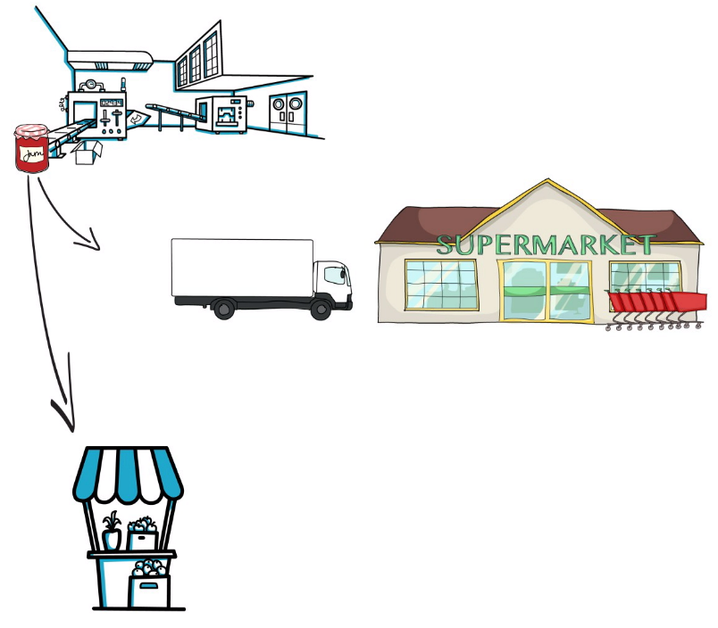
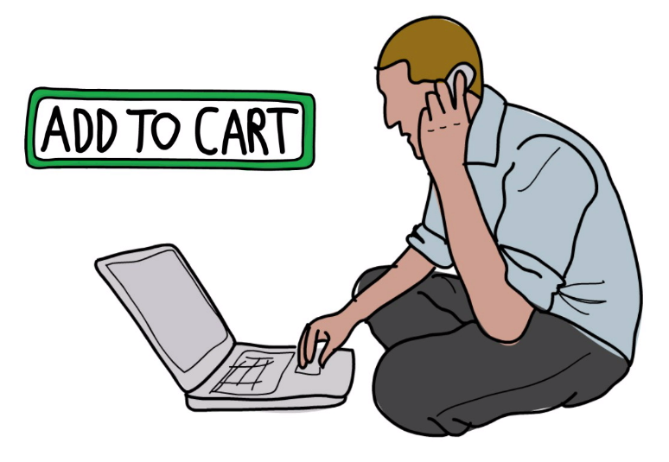
Case Study
They only sell their products to wholesalers, or at a farmer's market.
But their customers, time and time again, ask if they could order online.
Now they have brought onboard a team of six professionals to create a new eCommerce platform for the company so that they can sell their products over the internet.

Slide 28
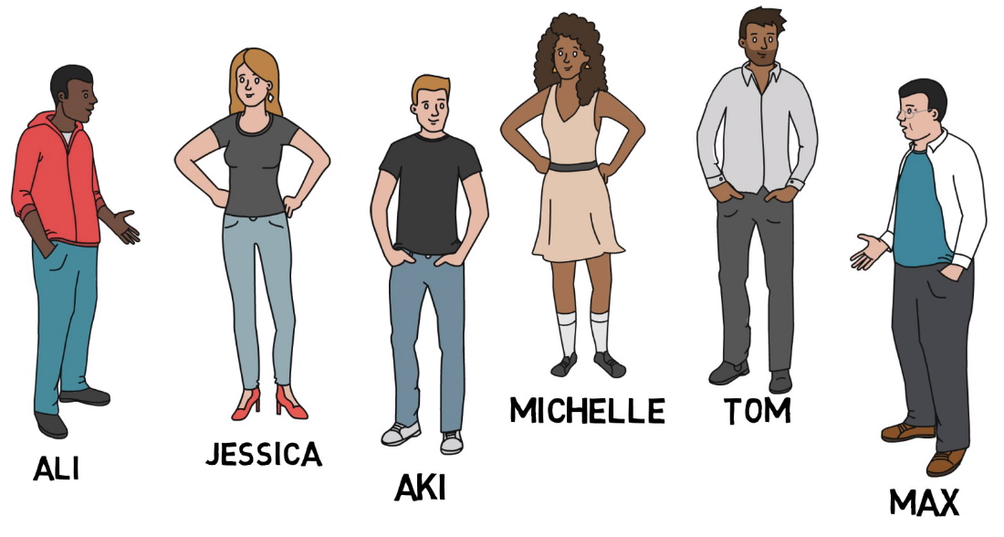
Meet The Team
Ali has experience with Scrum and has proposed to give Scrum a try for this project.
A Scrum team consists of a Scrum master, a product owner, and the developers.
Scrum Master
Developers
Product Owner
Jessica has a good understanding of eCommerce and has been involved in similar projects in the past.
Aki, Michelle, Tom, and Max, bring a mixed set of skills on design, programming, and testing, all crucial to the building of the eCommerce side.

Slide 29
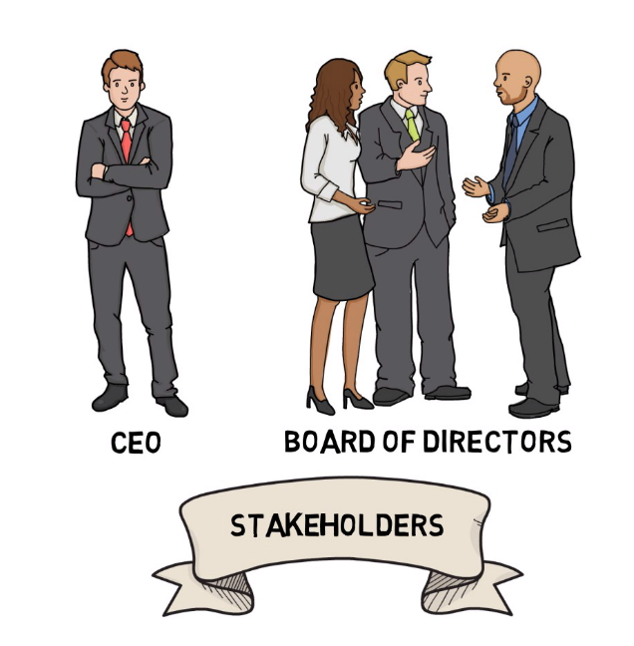
Meet The Team
The company CEO and the board of directors are the ones who wanted to have the eCommerce solution, and they all know that the future of this company depends on the outcome of this project. So, they are the stakeholders in this project.

Slide 30
Thank You
Image Placeholder

